Slide 1

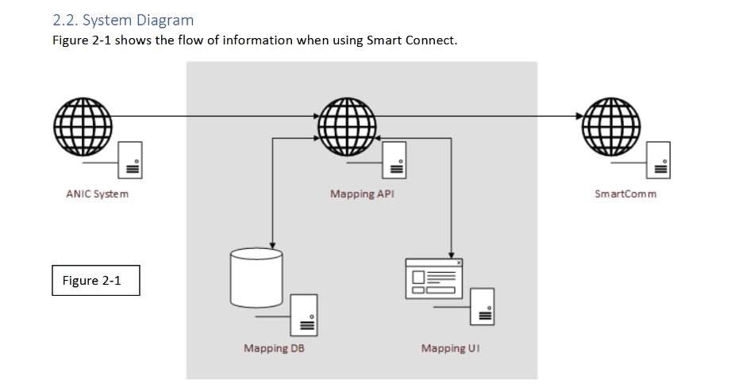
Alaska National Insurance Company
Goal
The Goal of the ANIC print project was to create a new workflow for printing insurance policy documents that would require less human intervention for error correction.
The proposed solution gave power to business users to determine what shows up on documents and how that they did have before.
The system depending on multiple vendors working together to create a complete end to end solution. In order for other vendors to integrate well with the software Affirma was building and clearly define the work that was to be done, technical documentation was required.
Documentation was also important to allow the client’s development team to follow along with development so that they could potentially take over support of the software.
Deliverables
Created a printing middleware that formatted XML passed from an insurance policy software and forwarded the formatted XML to a template based printing platform.
Technical writing had to be detailed enough for dependent software to integrate on both sides of the middleware.
The document produced was a mix of a functional specification and a technical specification.
Result
The project has been a success and has allowed the client control over their processes that were not possible before.
The technical documentation allowed for newcomers to the project to ramp up quickly by themselves.
The technical documentation acted as a reference for multiple development teams to understand system integrations.

